Slide 1

Vel Tech Rangarajan Dr. Sagunthala R&D Institute of Science and Technology
School of Computing
Department of Computer Science and Engineering
10211CS224 / FULL STACK APPLICATION DEVELOPMENT (JAVA)
END SEMESTER PROJECT REVIEW
Date: 06-05-2026
Smart Campus Event Management System
SDG: SDG 9 – Industry, Innovation and Infrastructure
Presented By:
SANGA CHANDU – VTU27286 – 23UECS0505.
Courses Handling Faculty:
Dr. S . HEMAMALINI – M.E., Ph.D.,

Slide 2
INTRODUCTION
1
Background of the problem:
Many colleges and universities still manage events manually or through scattered systems like notices, WhatsApp groups, or spreadsheets. This leads to issues such as miscommunication, missed registrations, lack of centralized data, and difficulty in tracking participants or event details.
Why this project is important:
It helps automate event creation, registration, notifications, and participant tracking using modern web technologies and database systems. It improves communication and reduces manual workload for organizers.
Real-world relevance:
This system is widely applicable in educational institutions, corporate organizations, and communities where multiple events are conducted regularly. Similar systems are used in universities, tech fests, workshops, seminars, and conference management platforms.
Brief overview of the system:
A responsive web-based application that allows users (students and organizers) to view, register, and manage campus events.
2
3
4
5
6
7
8
9

Slide 3
PROBLEM STATEMENT
In many educational institutions, campus events such as workshops, seminars, cultural programs, and technical fests are managed using manual methods or disconnected digital tools. This often leads to problems like inefficient communication, difficulty in event registration, data mismanagement, lack of real-time updates, and poor coordination between organizers and participants.
There is a need for a centralized, user-friendly system that can streamline the process of event creation, registration, and management. The system should allow organizers to efficiently manage event details and participants, while enabling students to easily browse events, register, and receive timely updates.
1
2
3
4
5
6
7
8
9

Slide 4
OBJECTIVES
1
To design and develop a centralized system for managing events efficiently.
To provide a user-friendly interface for browsing and registering for events.
To enable organizers to create, update, and manage event details easily.
To store and manage event and participant data using MySql Databasefor quick and lightweight database operations.
To reduce manual work and improve overall system efficiency.
2
3
4
5
6
7
8
9

Slide 5
PROPOSED SYSTEM
Event management is often handled using manual or scattered systems.
Users face difficulty in finding and registering for events.
There is no centralized platform to manage event details efficiently.
Organizers struggle to track participants and update event information.
Existing systems do not provide smooth user experience.
There is a need for a system that ensures efficient event handling.
1
2
3
4
5
6
7
8
9

Slide 6
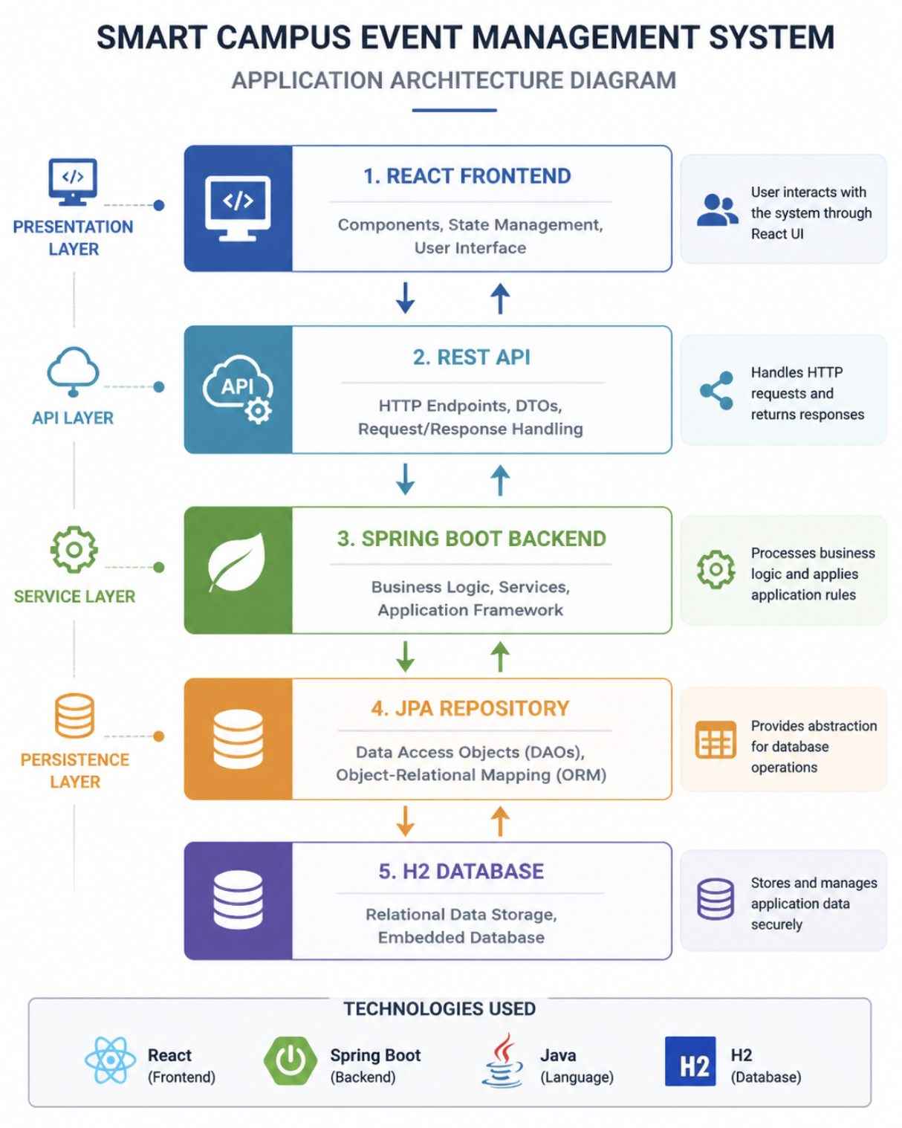
PROPOSED SYSTEM ARCHITECTURE
1
2
3
4
5
6
7
8
9

Slide 7
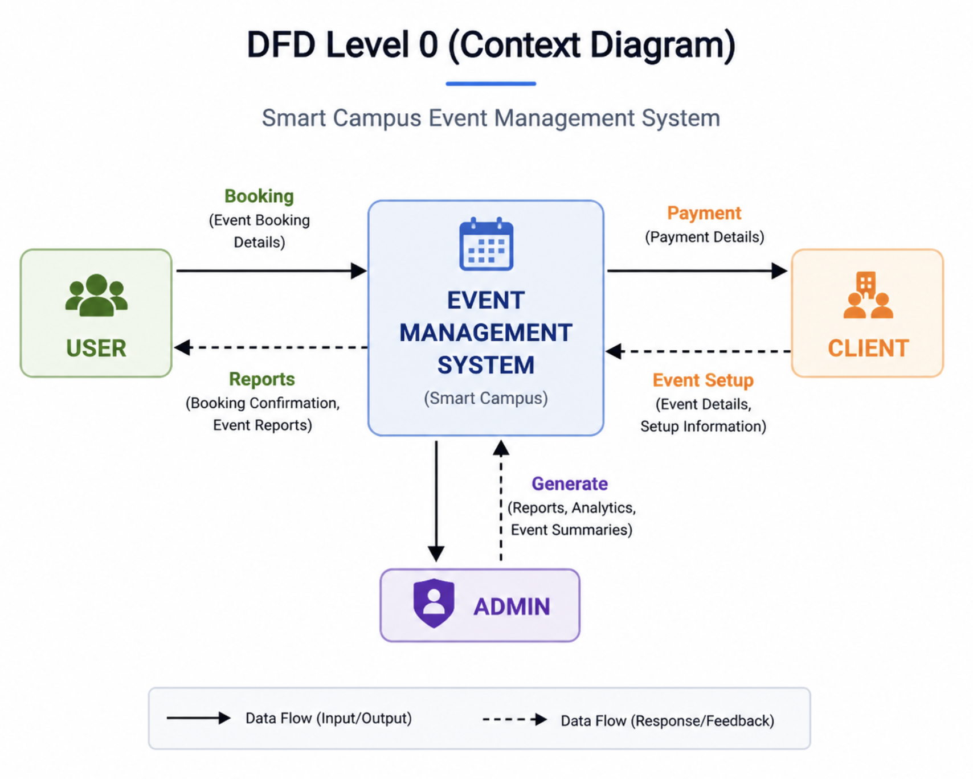
WORKFLOW
Dataflow diagram:
1
2
3
4
5
6
7
8
9

Slide 8
TECHNOLOGIES USED
Frontend:
1.HTML5
2.CSS3
3.Javascript
Backend:
1.Java Spring Boot
2. MySql Database
Tools:
1.Eclipse
Software Requirements:
1.Windows
2. Web Browser
1
2
3
4
5
6
7
8
9

Slide 9
MODULE DESCRIPTION
Module 1: Event Management:
Display Events Dynamically.
Organize Events By Category.
View Event Details.
Module 2: Registration Management:
Register For Events.
Cancel Registration.
View Registered Events.
Module 3: Data Persistence Module:
Stores Event & User Data in MySql DataBase.
Retrieves Data After Refresh.
Module 4: Notification Module:
Send Confirmation Email After Registration.
Notify Users About Event Updates.
1
2
3
4
5
6
7
8
9

Slide 10
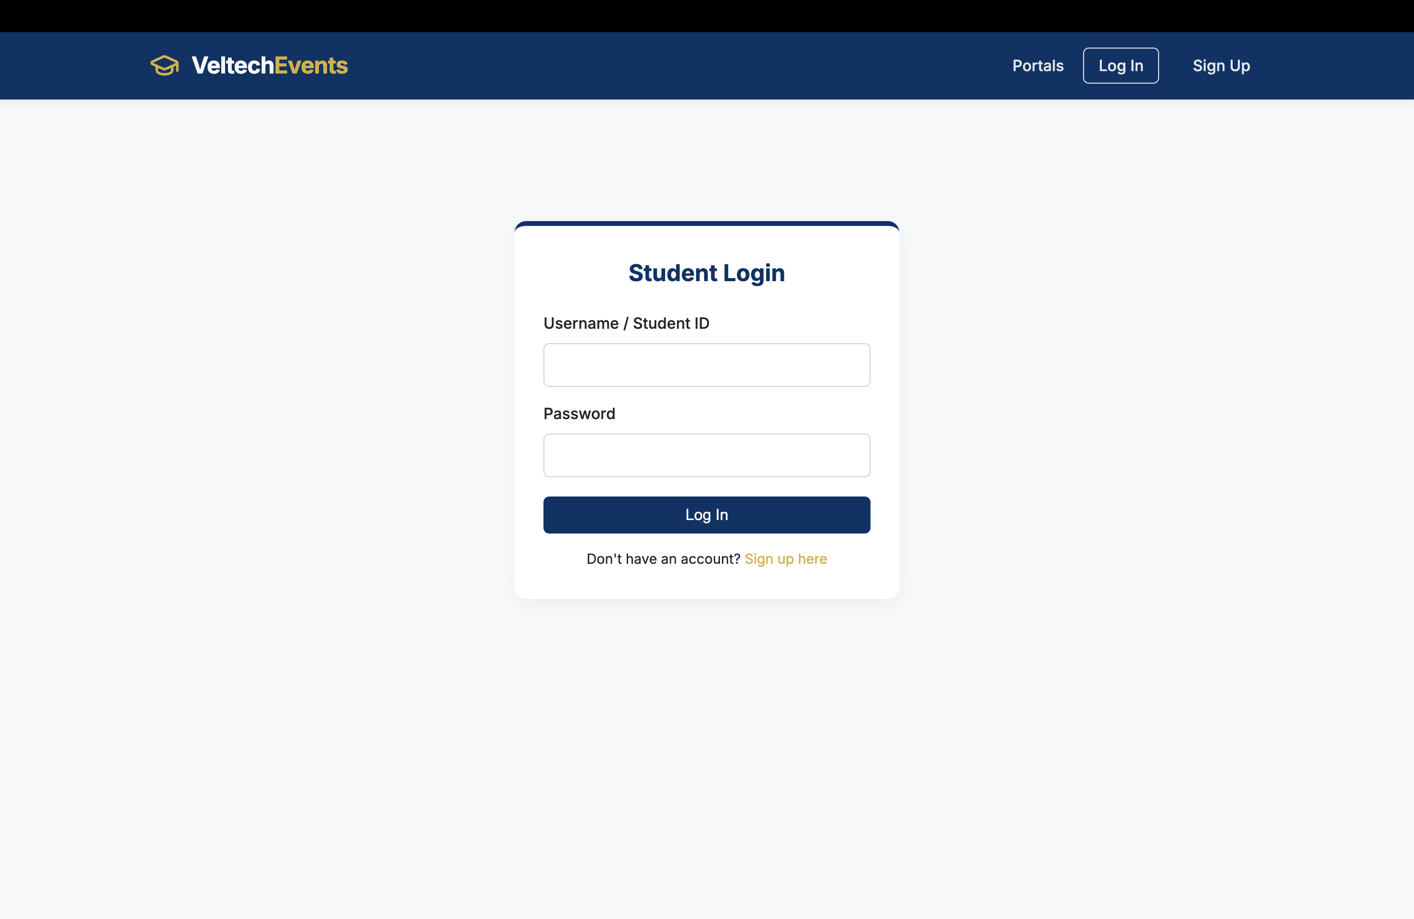
IMPLEMENTATION SCREENSHOTS
Login Page :
1
2
3
4
5
6
7
8(A)
9

Slide 11
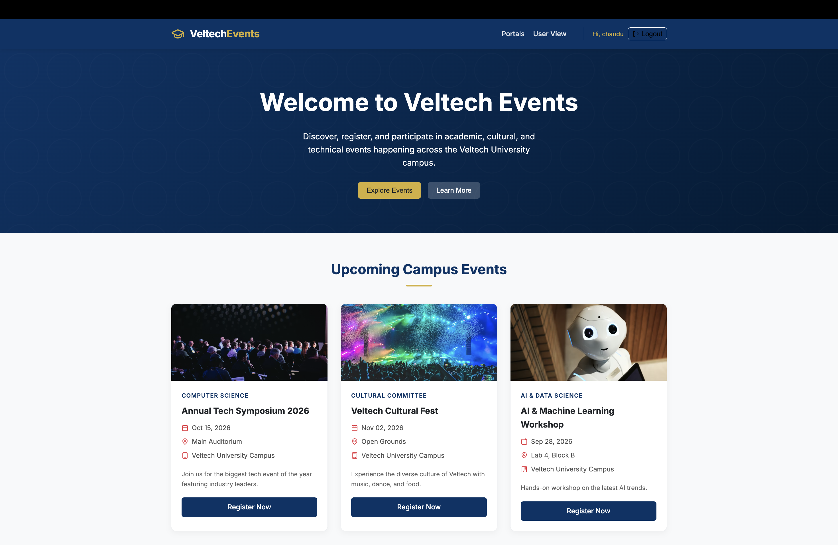
IMPLEMENTATION SCREENSHOTS
Home Page:
1
2
3
4
5
6
7
8
9

Slide 12
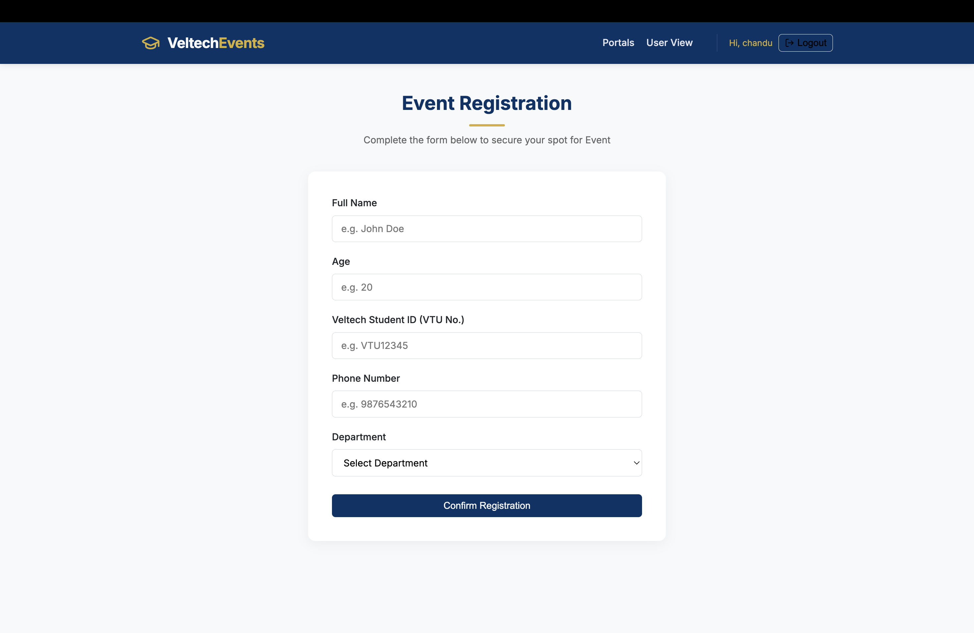
IMPLEMENTATION SCREENSHOTS
1
2
3
4
5
6
7
8(C)
9

Slide 13
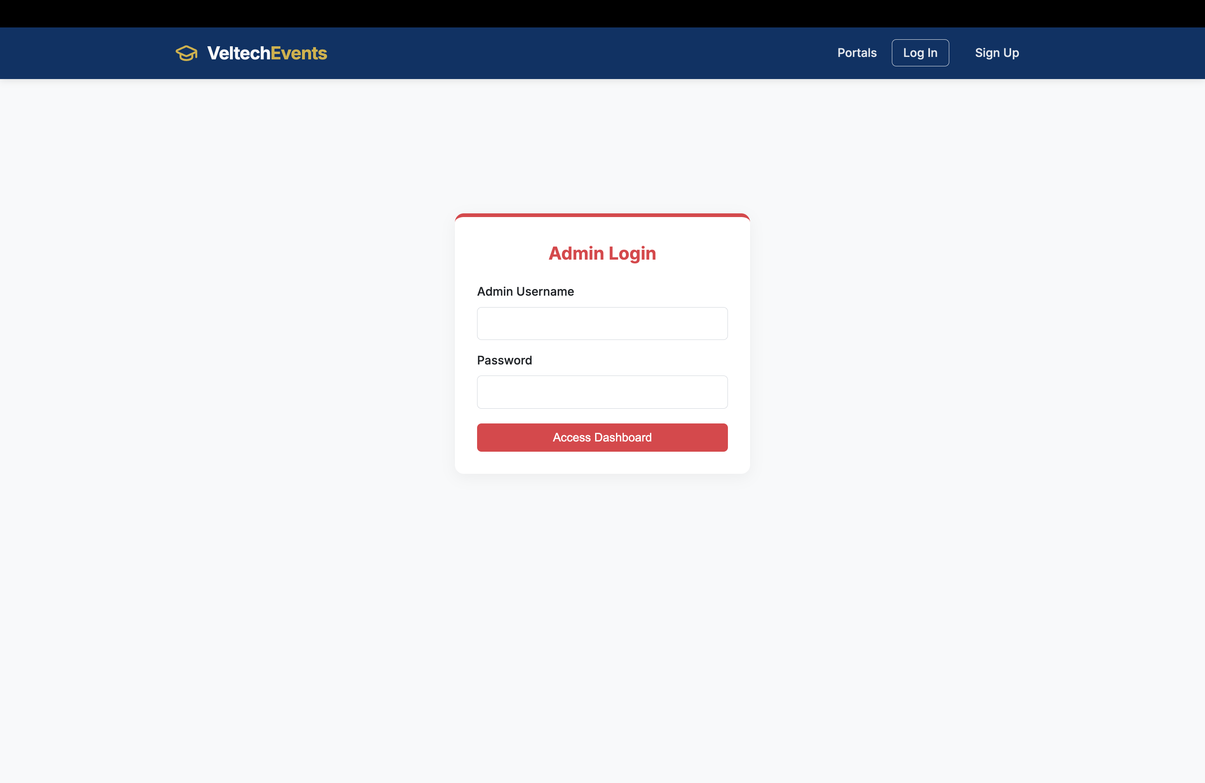
IMPLEMENTATION SCREENSHOTS
1
2
3
4
5
6
7
8(C)
9

Slide 14
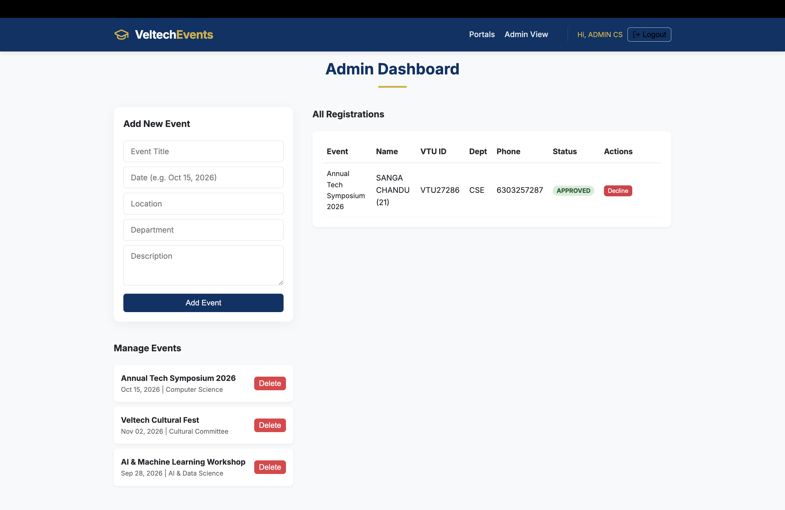
IMPLEMENTATION SCREENSHOTS
1
2
3
4
5
6
7
8(C)
9

Slide 15
ADVANTAGES & LIMITATIONS
Advantages:
Easy event registration process.
Data persistence using MySql Database.
Real-time updates for users.
Improves coordination and reduces manual work.
User-friendly and responsive interface.
Limitations:
Limited scalability for large-scale usage.
Basic notification system email only.
Less support for advanced analytics features.
Data security depends on implementation.
1
2
3
4
5
6
7
8
9

Slide 16
Thank you

